Slide 1

Introduction to Bacteriology
2nd Year – 1st semester
Dr. Munira Ch. Ismail

Slide 2
Learning Objectives
Shapes of bacteria
Structure of bacterial cell
Different ion between Gram positive and Gram negative bacteria cell envelope
Cell wall
Chemical composition of the cell wall
Special components of Gram negative cell wall
Special components of Gram positive cell wall
Cytoplasmic ultra structures

Slide 3
6. Special components of Gram positive cell wall
Teichoic acid:
Dry weight (50% cell wall) and (10% total cell).
water soluble polymer of glycerol or ribitol phosphate (phosphodiester linkage).
2 types: wall and lipoteichoic acid
Teichoic acid (sugar acid instead phosphoric acid)
Polysaccharides

Slide 4
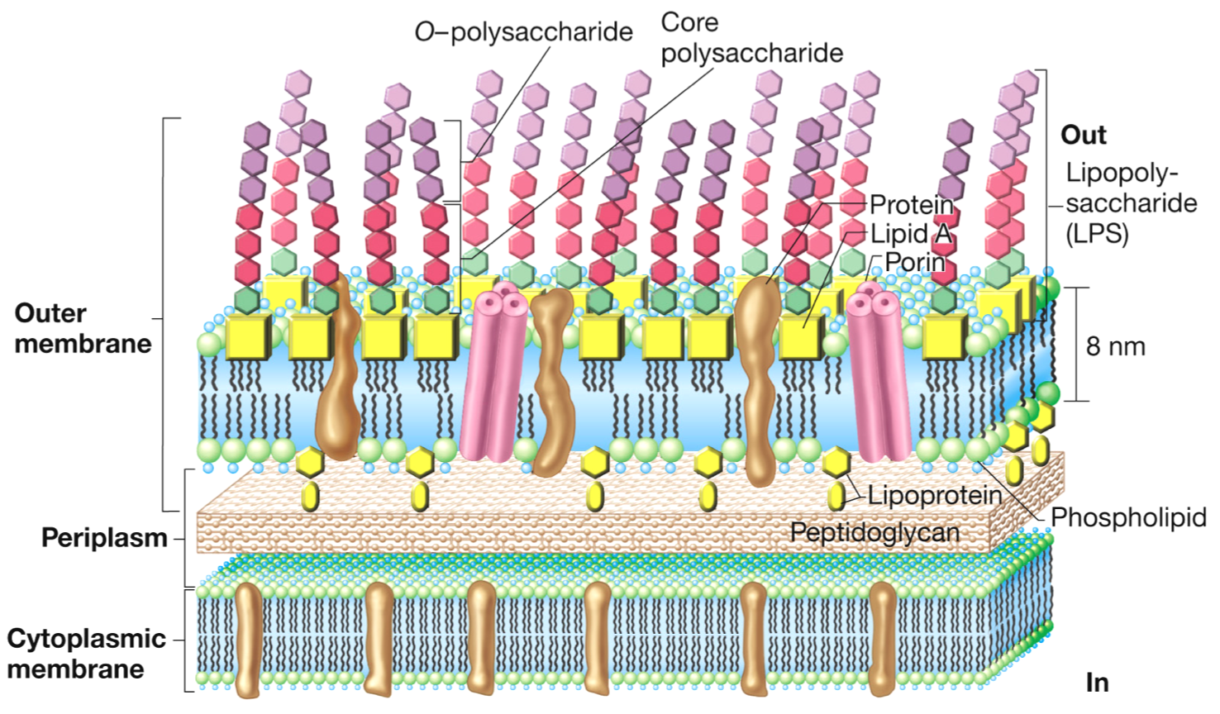
Outer membrane in cell wall of gram negative bacteria

Slide 5
7. Special components of Gram negative cell wall
Lipoprotein
Outer membrane
Lipopolysaccharides
LPS is composed of:
Lipid-A:
Polysaccharide: consists of
Core polysaccharide
O polysaccharide (O antigen)

Slide 6
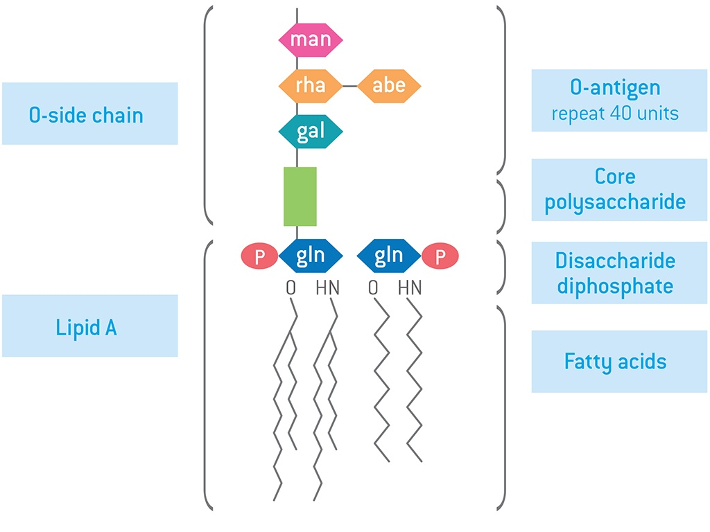
LPS

Slide 7
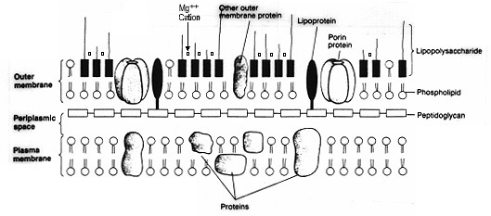
Periplasmic membrane
Cytoplasmic membrane

Slide 8
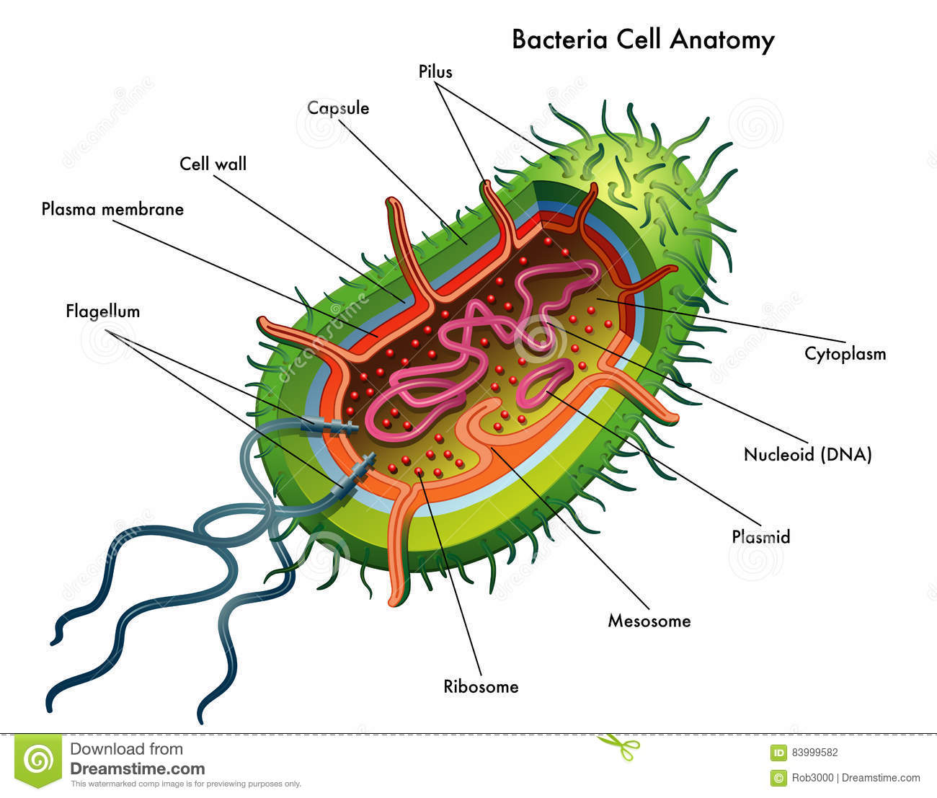
8. Cytoplasmic ultrastructure
Mesosomes (Septal and Lateral)
Ribosomes
nuclear body
Plasmids (some)

Slide 9
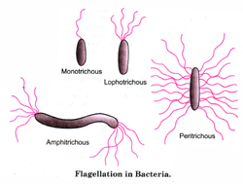
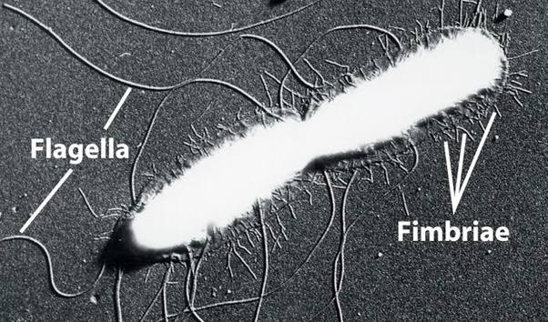
Cellular element external to the cell envelope:
Flagellum
Pilus
Glycocalyx

Slide 10
Flagellum
Flagellar arrangements
Atrichous: Bacteria with no flagellum
Monotrichous: Bacteria with single polar flagellum.
Lophotrichous: Bacteria with bunch of flagella at one pole.
Amphitrichous: Bacteria with flagella at both poles.
Peritrichous: Bacteria with flagella all over their surface.

Slide 11
Home Work 1
Differentiation between Prokaryotes and Eukaryotes

Slide 12

Any Questions?

